Slide 1
CSR Connect: A Hub for Corporate Social Responsibility
PIP104 PROFESSIONAL PRACTICE-II
VIVA-VOCE
Batch Number:
Roll Number | Student Name
20201CSE0571 20201CSE0590 20201CSE0585 | Pavan E R Sangamesh Kishor Kumar KR
Under the Supervision of
Mr.Jerrin Joe Francis
School of Computer Science & Engineering
Presidency University

Slide 2
Introduction
In today's business world, Corporate Social Responsibility (CSR) has become a vital aspect of responsible practices. Despite commendable individual CSR efforts, challenges like resource constraints and limited awareness hinder their full potential.
Our ambitious project introduces the Common CSR Portal, a cutting-edge platform fostering collaboration among organizations and individuals for impactful CSR initiatives.
CSR Connect aims to break down barriers and unite diverse groups, amplifying their collective impact.
By strategically pooling resources, it overcomes limitations in executing large-scale or remote CSR activities, ensuring a profound contribution to societal well-being.
The portal serves as a dynamic hub, connecting corporates and individuals to discover, engage, and actively participate in social events, fostering shared responsibility.
Utilizing advanced technology, CSR Connect streamlines coordination and optimizes resource allocation, empowering participants to contribute effectively to a common social mission.
Beyond a platform, CSR Connect is a transformative force, signaling positive change and envisioning a future where collective efforts redefine social responsibility.
Join us on this journey as we delve into CSR Connect's features, impact, and transformative potential, shaping a future of positive societal influence.

Slide 3
Literature Review
Sl. No | Article | Review
1 | A proposed methodological framework for the evaluation of corporate social responsibility | Proposes a comprehensive framework for CSR implementation, covering various aspects and using qualitative and quantitative evaluation methods.
2 | Corporate Social Responsibility in India – A way to Socio Economic Development | Analyzes the potential of CSR for socio-economic development in India, discussing government initiatives and challenges.
3 | Impact of corporate social responsibility on corporate reputation: Indian Scenario | Investigates the relationship between CSR and reputation in India using a survey.

Slide 4
Literature Review
Sl. No | Article | Review
4 | Corporate Social Responsibility (CSR) in India: A Review | Offers a comprehensive and structured approach to evaluate CSR programs, with a framework adaptable to different sectors.
5 | The Role of Corporate Social Responsibility in India | Analyzes the importance of CSR for socio-economic development in India, including government initiatives.
6 | Corporate Governance and Corporate Social Responsibility: The Indian Context | Explores the interaction between corporate governance and CSR in India, using a survey to analyze perceptions.

Slide 5
Literature Review
Sl. No | Article | Review
7 | A study of corporate social responsibility (CSR) initiatives of selected organizations in and around Pune city, state of Maharashtra, India | Provides a localized analysis of CSR practices in Pune, focusing on perceptions and specific approaches.
8 | A Comparative Study of Corporate Social Responsibility Practices in India | Analyses CSR practices of Indian companies, focusing on their approach to balancing financial, social, and ecological goals.
9 | A literature review: Corporate social responsibility practices of Indian companies | Reviews CSR practices in India, highlighting the shift towards a more impactful approach aligned with business strategy.

Slide 6
Literature Review
Sl. No | Article | Review
10 | Role of Sustainable Development Goals and Corporate Social Responsibility in India’s Growth: Opportunities and Challenges | Emphasizes the alignment between CSR and SDGs, discussing opportunities and challenges for India's growth.

Slide 7
Research Gaps Identified
Long-Term Engagement & Measurable Outcomes:
Assess if CSR Connect sustains CSR activities over time.
Evaluate its impact on specific social and environmental goals.
Influencing Factors & Significance:
Examine elements like technology, user experience, and organizational culture that affect CSR Connect's long-term success.
Insights are critical for platform development, resource management, and policy decisions.
Enhance theoretical understanding of sustained social change via CSR platforms.
Research Approach & Impact:
Conduct a longitudinal, mixed-methods study tracking behavior changes and outcomes.
Combine quantitative data with qualitative analysis from various stakeholders.
Focus on understanding user motivations and platform usage patterns.

Slide 8
Research Gaps Identified
Potential Study Impacts:
Strategic CSR Platform Development:
Develop evidence-based strategies for more effective CSR initiatives.
Enhanced Social and Environmental Impact:
Aim for greater and lasting change in CSR efforts.
Theoretical Contributions:
Advance knowledge on the interplay between CSR, technology, and societal impact.

Slide 9
Proposed Methodology
CSR Connect, an organized Common CSR portal, empowers corporates and individuals to collectively contribute to social responsibility initiatives.
Unique Features:
Centralized Platform: Provides a unified space for organizations to showcase and collaborate on CSR projects.
Enhanced Visibility: Broadcasts CSR initiatives to a wider audience, increasing participation and support.
Resource Optimization: Enables organizations to pool resources and expertise, maximizing impact.
Streamlined Collaboration: Facilitates seamless communication and coordination among organizations.
Impactful Social Change: Empowers a collective effort to address social and environmental challenges.
CSR Connect: Bridging the Gap for Collective Social Impact.

Slide 10
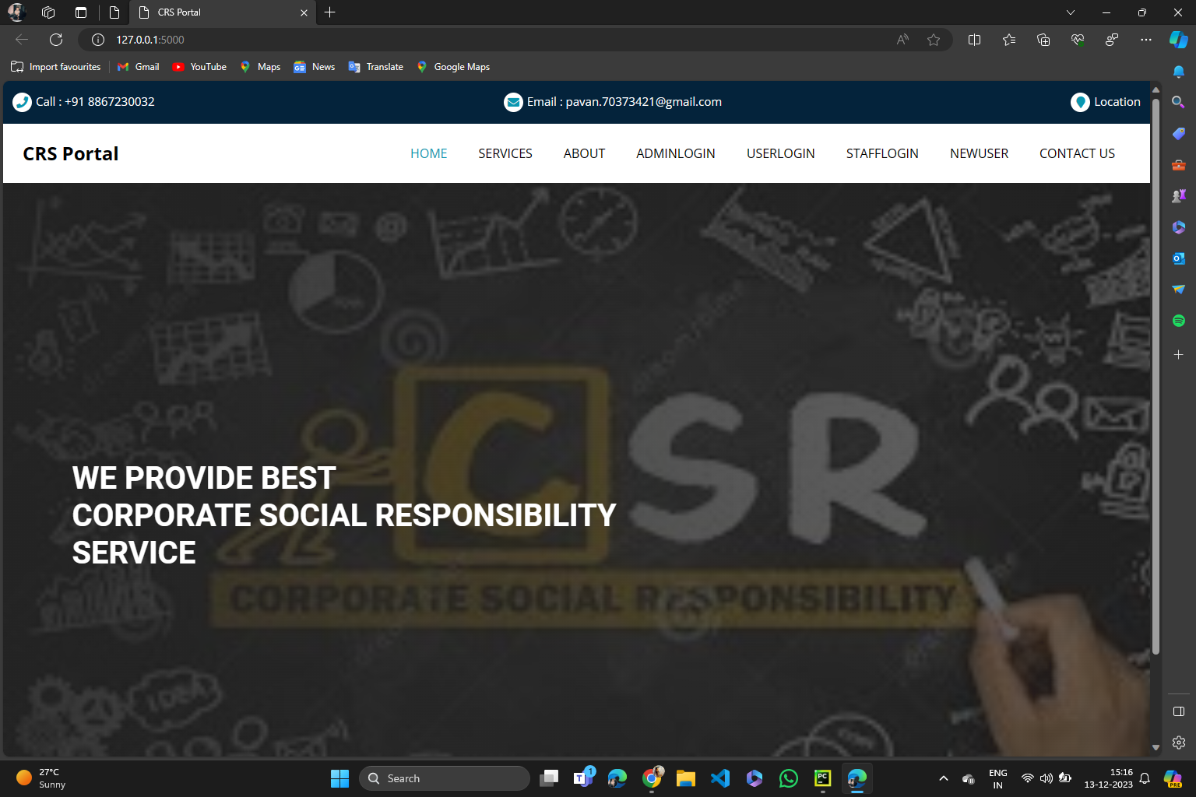
CSR Portal (Home page)

Slide 11
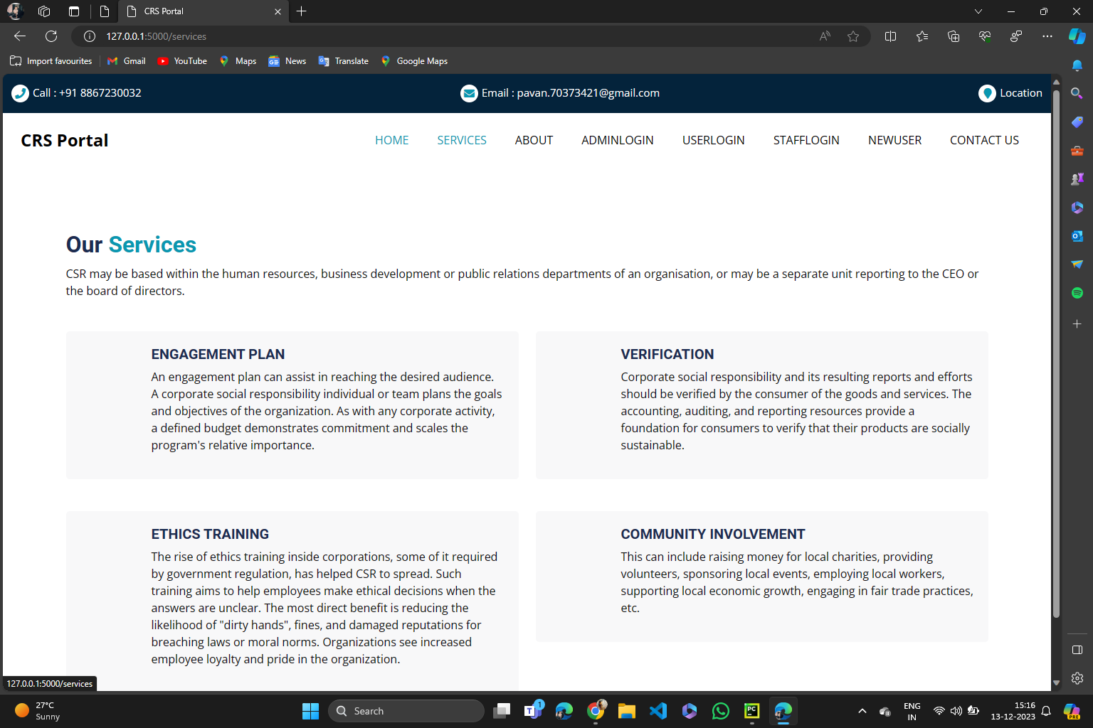
CSR Portal (Service)

Slide 12
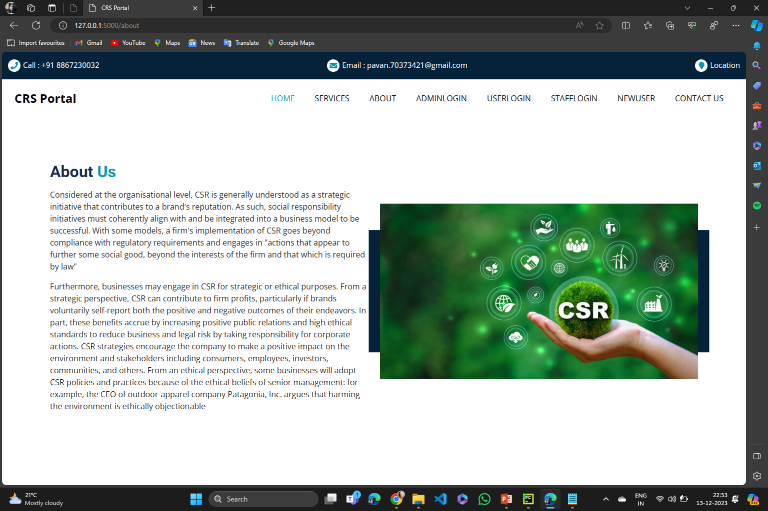
CSR Portal (About us)

Slide 13
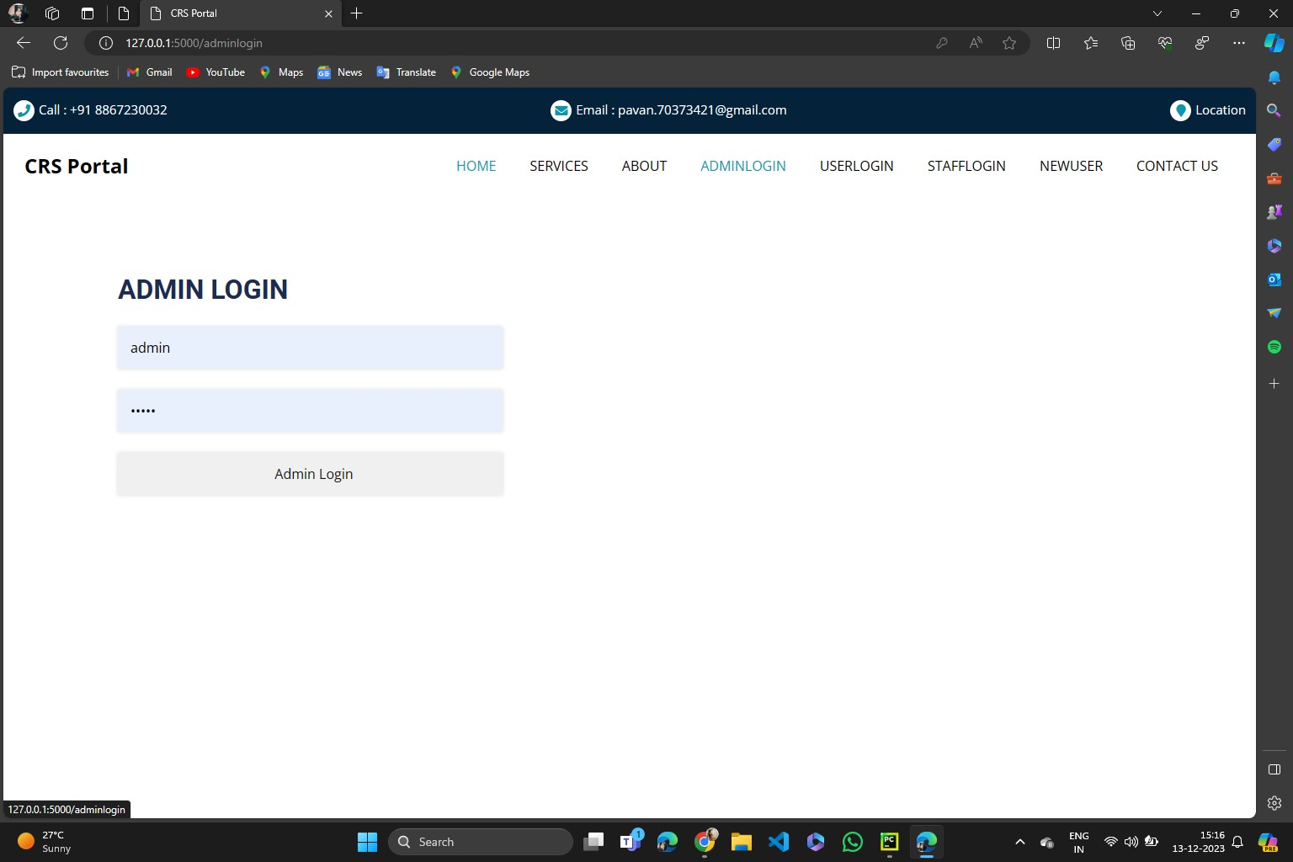
Modules
Module 1: Login Setup (Admin Login)
This provides a simple function for logging admins in to the system. It takes the admin's username and password as input, validates the input parameters, checks if the admin exists in the database, checks if the password is correct, and returns the admin object if the login is successful, or None otherwise. This function can be used to create a login form for admins on the website or to automate the admin login process.

Slide 14

Modules
Module 2: Login Setup (NGO Login)
This provides a simple function for logging staff members in to the system. It takes the staff member's ID and password as input, validates the input parameters, checks if the staff member exists in the database, checks if the password is correct, and returns the staff object if the login is successful, or None otherwise. This function can be used to create a login form for staff members on the website or to automate the staff member login process.

Slide 15

Modules
Module 3: Login Setup (Corporates Login)
This provides a simple function for logging users in to the system. It takes the user's email address and password as input, validates the input parameters, checks if the user exists in the database, checks if the password is correct, and returns the user object if the login is successful, or None otherwise. This function can be used to create a login form on the website or to automate the user login process.

Slide 16
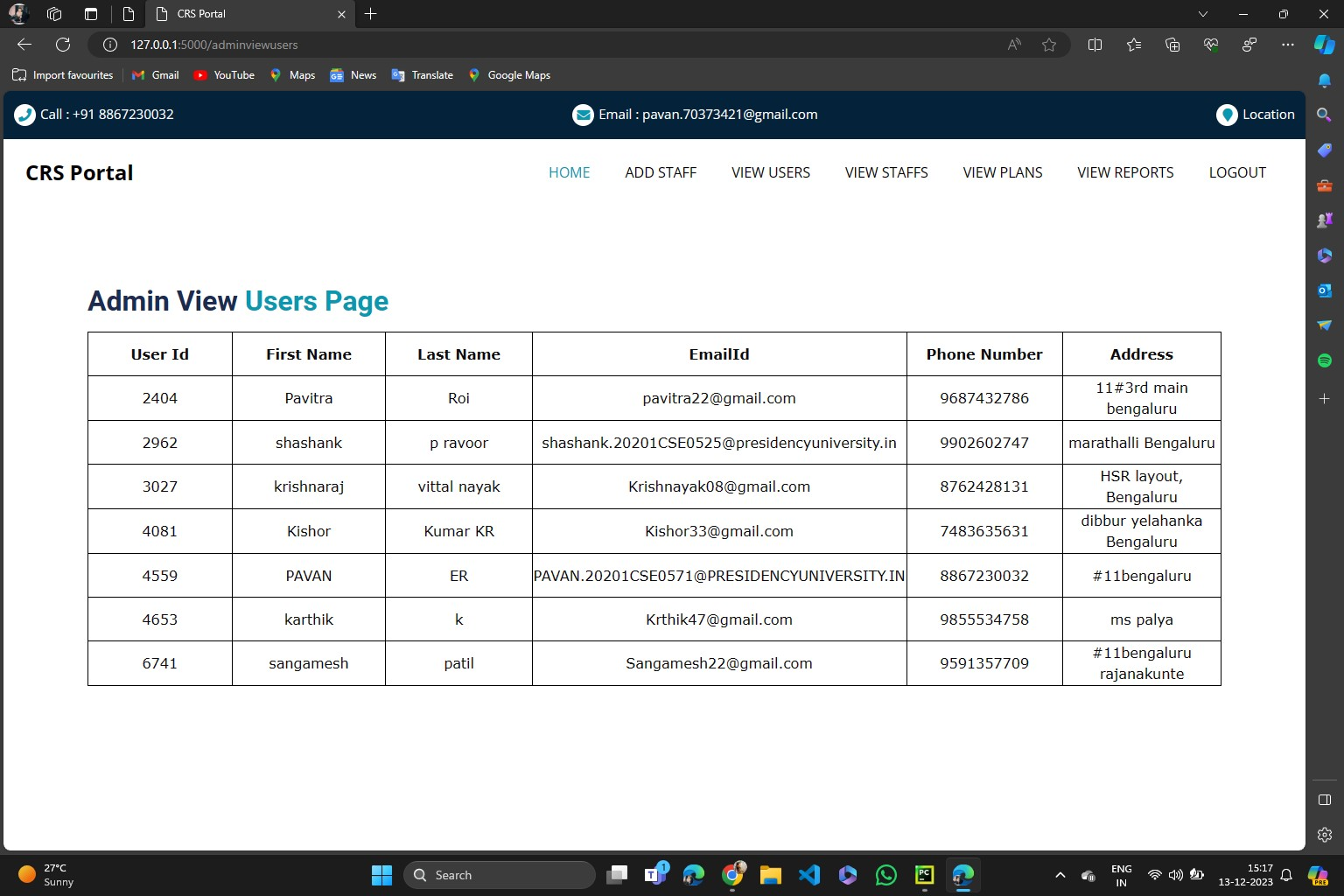
Modules
Module 4: Organization Management
This will render the “admin_view_users.html” template with the list of all users. We can also use the “get_user_by_id()” method to get a specific user by their ID. For example:
user = AdminViewUsersModule.get_user_by_id(12345)
This will return the user object with the ID 12345. We can then use the user object to get information about the user, such as their name, email address, and phone number.

Slide 17
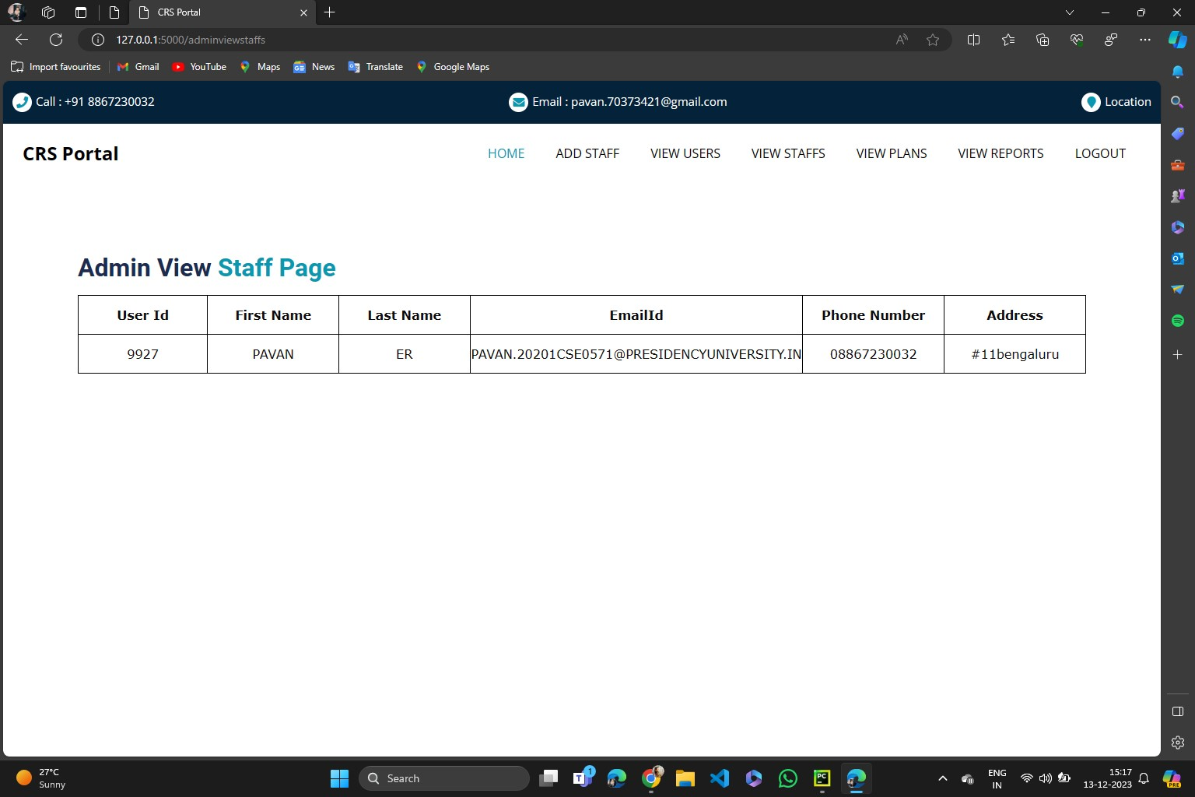
Modules
Module 4: Organization Management
This will render the “admin_view_staff.html” template with the list of all staff members. We can also use the “get_staff_by_id()” method to get a specific staff member by their ID. For example:
staff_member = AdminViewStaffModule.get_staff_by_id(12345)
This will return the staff member object with the ID 12345. We can then use the staff_member object to get information about the staff member, such as their name, email address, and phone number.

Slide 18
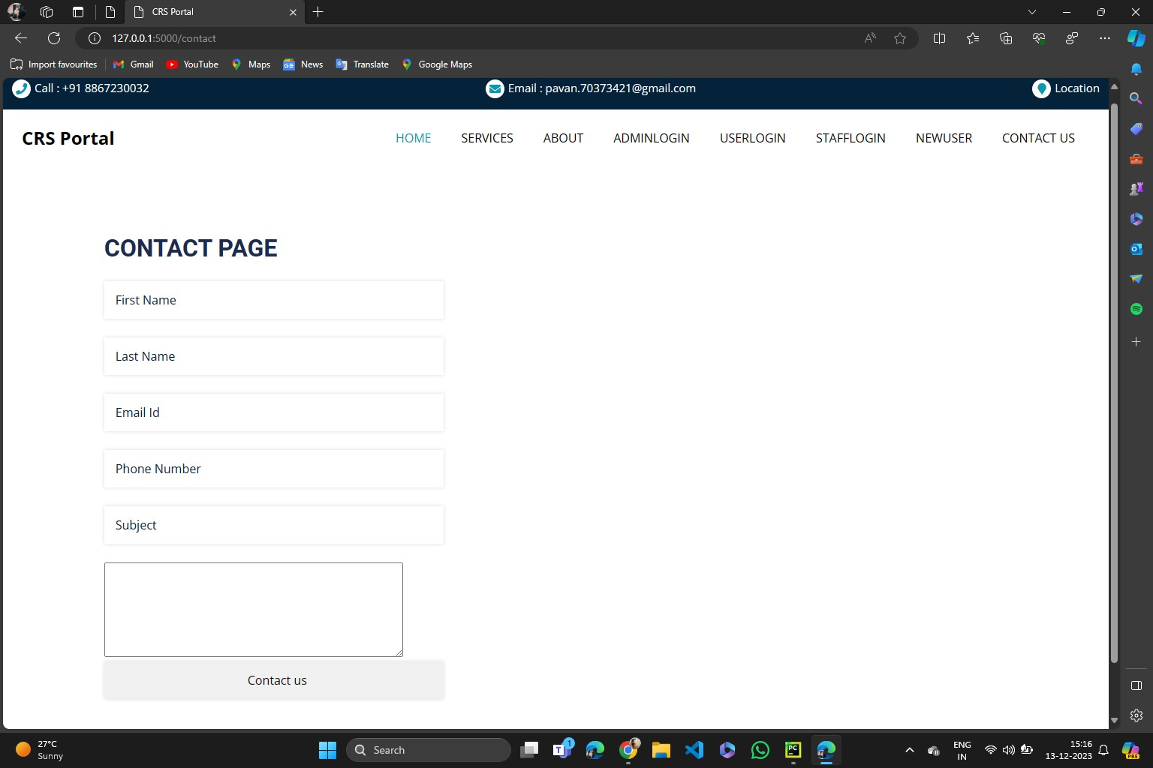
Modules
Module 4: Organization Management
This will render the “contact.html” template with the contact information. We can then use the contact_information object to get the phone number and email address of the contact page. For example:
phone_number = contact_information['phone_number']
email_address = contact_information['email_address']
We can then use this information to display the contact information on the page or to send a message to the contact person.

Slide 19
Objectives
Central Platform for Collaboration:
Unify diverse organizations to collaborate on CSR projects.
Facilitate coordination and communication across entities of varying sizes.
Foster synergies and best practice sharing for more effective CSR strategies.
Alignment with Values and Goals:
Help organizations find CSR projects that match their values and objectives.
Enhance engagement and commitment by aligning projects with corporate identity.
Pooling Resources and Expertise:
Enable collaboration to combine financial, technical, and human resources.
Enhance the scale, scope, and impact of CSR initiatives.
Increasing Reach and Participation:
Lower barriers to participation for individuals and organizations.
Broaden contributor base, enhancing resources and legitimacy of CSR projects.

Slide 20
System Design & Implementation
Frontend Development:
HTML, CSS, and JavaScript form the foundation for an intuitive and visually appealing user interface.
JavaScript adds dynamism, enabling real-time updates and interactive features.
Backend Development:
Python is utilized for core operations, including user authentication and database interactions.
Firebase Cloud Firestore manages user data, events, and project information, offering scalability and security.
Database Management:
Firebase Cloud Firestore serves as the database, providing scalable and secure cloud-based storage.
Optimized for performance with caching and session management.

Slide 21
System Design & Implementation
Additional Technologies:
Web Workers handle resource-intensive tasks, ensuring smooth user interactions.
Socket Server enables real-time communication, vital for features like live chat and collaborative editing.
Key Features and Components:
Co-Browse: Python-powered feature for real-time collaboration on CSR projects.
DOM Player: JavaScript-based component enabling the recording and playback of web page interactions.
Events: Python-managed creation and organization, with Firebase storing relevant event data.
Recording and Streaming: Python facilitates live video and audio streaming capabilities.
Social Media Integration: JavaScript allows seamless sharing of content on various social platforms.

Slide 22
System Design & Implementation
Overall Integration:
Strategic selection of Python, HTML, CSS, JavaScript, and Firebase creates a powerful backend and engaging frontend.
Web Workers and Socket Server enhance responsiveness and real-time communication.
CSR Connect is positioned to efficiently meet user demands, promoting collaborative CSR activities.

Slide 23
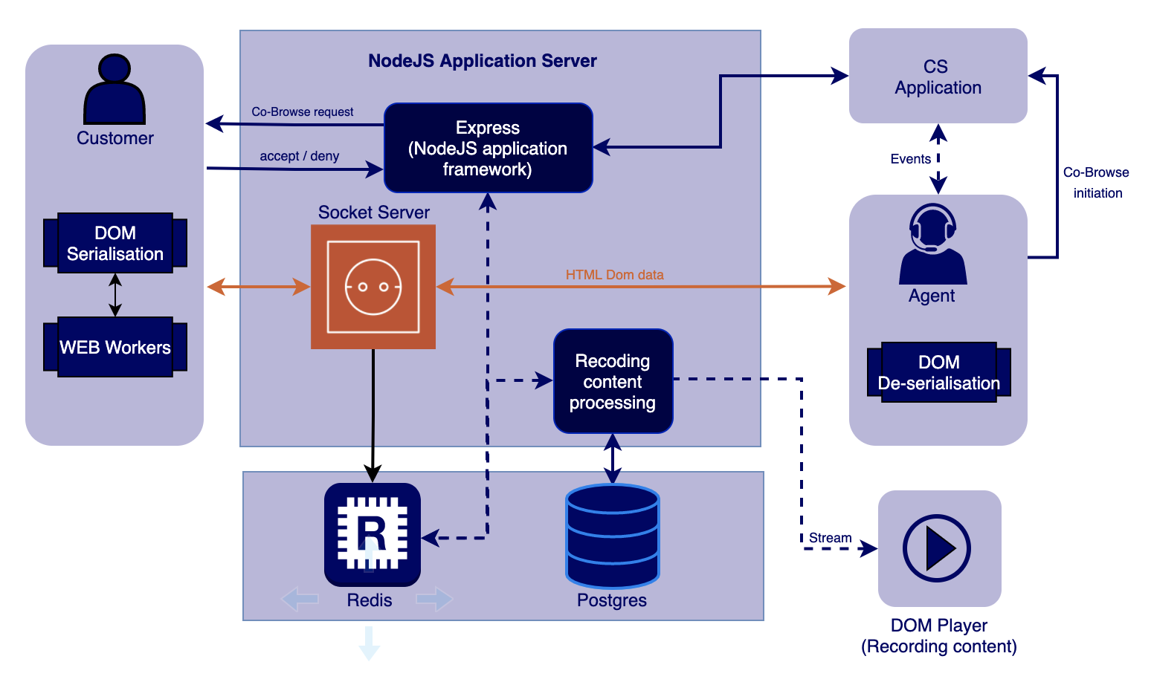
System Design & Implementation
Architecture diagram

Slide 24
System Design & Implementation
Node.js Application Server:
The Node.js Application Server serves as the primary server for Pega Co-Browse, responsible for managing communication between agents and customers. It plays a crucial role in processing and rendering web pages for the customer, ensuring a seamless experience during co-browsing sessions.
Express (NodeJS application framework):
Express, a Node.js application framework, provides a foundation for web app development in Pega Co-Browse. It efficiently manages routing, sessions, and serves static content. This framework enhances the development process, making it more structured and streamlined.
Socket Server:
The Socket Server is dedicated to facilitating real-time communication between agents and customers. It acts as a communication bridge, transmitting vital information on the customer's browsing activity. This real-time communication is fundamental for a synchronized co-browsing experience.

Slide 25
System Design & Implementation
DOM Serialization/De-serialization:
DOM Serialization/De-serialization is a critical process that involves converting the Document Object Model (DOM) of the customer's web page for network transmission. This ensures synchronization between the agent and customer views, allowing both parties to have consistent interactions with the web content.
Redis/Postgres:
Radis serves as an in-memory database, handling temporary data like browsing sessions, while Postures acts as a relational database for more permanent data such as customer information and co-browse recordings. This dual-database approach optimizes data management for different types of information.
Web Workers:
Web Workers are background scripts that run parallel to the main application, providing a mechanism to offload resource-intensive tasks. In Pega Co-Browse, Web Workers play a vital role inefficiently processing and rendering web pages without affecting the main thread's performance.

Slide 26
System Design & Implementation
Co-Browse Initiation:
Co-Browse Initiation marks the start of a co-browsing session triggered by customer interaction. This feature allows the agent to view and navigate alongside the customer on their web page, providing real-time assistance and support.
Events:
Events occur during co-browsing sessions, such as clicks or URL changes. These events are sent to the agent in real-time, allowing them to track and respond promptly to the customer's actions. This feature enhances the collaborative and interactive nature of the co-browsing experience.
DOM Player (Recording content):
The DOM Player is a crucial component that records the customer's browsing activity during co-browsing sessions. This recorded content can later be utilized for playback or in-depth analysis, providing insights into customer interactions and behaviors during the session.

Slide 27
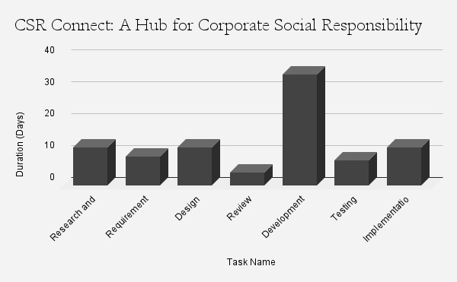
Timeline of Project
Timeline:

Slide 28
Outcomes / Results Obtained
User Engagement:
Streamlined onboarding via User Management module.
Users register, manage profiles, and customize preferences seamlessly.
Result: Active user base readily participating in CSR activities.
Organization Participation:
Structured engagement with Organization Management module.
Facilitates systematic registration, profile management, and project discovery.
Result: Organizations matched with suitable CSR projects based on mission and expertise.
CSR Project Management:
Empowers organizations to create, submit, and showcase impactful CSR initiatives.
Includes a review and approval process for mission-aligned projects.
Result: Meaningful contributions to societal challenges.

Slide 29
Outcomes / Results Obtained
Volunteer Matching:
Volunteer Management module enables efficient matching of skills and interests.
Matching and placement submodule ensures effective volunteer contribution.
Result: Volunteers engaged in projects aligning with their abilities.
Resource Management:
Transparent donation and request system via Resource Management module.
Tracks and allocates resources efficiently to address project needs.
Result: CSR projects receive necessary support for success.
Communication and Collaboration:
Communication module with features like Project Discussion Forum fosters collaboration.
Stakeholders share ideas, discuss projects, and stay updated.
Result: Community and shared responsibility among users and organizations.

Slide 30
Outcomes / Results Obtained
Recognition System:
Volunteer Hours Tracking and Recognition submodule acknowledges contributions.
Positive feedback loop encourages ongoing volunteer engagement.
Result: Enhanced overall volunteer experience and sustained participation.
Resource Needs Assessment:
Resource Needs Assessment and Prioritization submodule evaluates project requirements.
Offers insights to prioritize based on importance and impact.
Result: Judicious resource allocation for maximum initiative effectiveness.
Platform Integration:
Seamless integration of HTML, CSS, JavaScript, Python, NodeJS, Firebase, Redis, and Postgres.
Creates a robust and scalable platform for enhanced user experience.
Result: Efficient communication, informed decision-making, and a powerful CSR platform.

Slide 31
Conclusion
CSR Connect is a game-changer in corporate social responsibility. It's a platform that brings together organizations and individuals, making it easier to manage CSR activities in a centralized and transparent way.
The platform includes various modules for managing users, projects, volunteers, resources, and communication. This makes sure that everyone involved can contribute effectively to social and environmental issues.
The impact of CSR Connect is significant. It builds a stronger community by improving collaboration and sharing knowledge, and it makes CSR efforts more effective by focusing on transparency and proper resource use.
The platform is particularly good at matching volunteers with projects that fit their skills, which improves their experience and the impact of their work.
Overall, CSR Connect is more than just a tool for CSR; it's a catalyst for positive change. It shows how technology can bring people together to make a real difference in the world.
CSR Connect is leading the way to a future where corporate social responsibility is a key part of how we all work together for a better world.

Slide 32
References
[1] Konstantin G. Aravossis and Nikolaos A. Panayiotou, "A proposed methodological framework for the evaluation of corporate social responsibility," 2006. Vol 98, pp 87-95, WIT Press 2006 DOI:10.2495/EEIA060091
[2] Dr. Lakshmana, "Corporate Social Responsibility in India – A way to Socio-Economic Development," 2011. DOI:10.15373/2249555X/NOV2012/14 Vol. 10, Issue, 12(D), pp. 36292-36298, December, 2019
[3] Miklesh Prasad Yadav, "Impact of corporate social responsibility on corporate reputation: Indian Scenario," 2014. Vol.02 Issue-05, (May, 2014) ISSN: 2321-1784 (Impact Factor-3.259)
[4] Sudeshna Saha and Neelmani Jaysawal, "Corporate Social Responsibility (CSR) in India: A Review," 2015. DOI:10.20896/saci.v3i2.146 License: CC BY 4.0 November 2015: Space and Culture India 3(2):81-93
[5] Nidhi Tandon and Simran Kaur, "The Role of Corporate Social Responsibility in India," 2017. DOI:10.20896/saci.v3i2.156 vol. 55, no. 2, pp. 215-22

Slide 33
References
[6] Badur Raja Mannar, "Corporate Governance and Corporate Social Responsibility: The Indian Context," 2017. Volume 9 Issue 1 [Year-2018] ISSN 2319-9202 DOI:10.2495/EEIA0600671
[7] Mohammad Amir, "A study of corporate social responsibility (CSR) initiatives of selected organizations in and around Pune city, state of Maharashtra, India," 2019. Vol. 4 • Nº 16 •Junio 2019ISSN 2477-9083 pp. 375 - 383 ISSN 2477-9083 Vol. 4 • Nº 16 • Junio 2019 ISSN 2477-9083
[8] Dr. Kiran Kakade, "A Comparative Study of Corporate Social Responsibility Practices in India," 2019. DOI:10.13140/RG.2.2.28202.47047 Vol.3, Issue 5(Sep.- Oct), pp. 17-27. , 17-27.
[9] Vethirajan . C, Ariyadevi . N, J.Antony Nancy, S.Jeya Chitra, "A literature review: Corporate social responsibility practices of Indian companies," 2020. May 2020 Aegaeum 8(5):236-251
[10] Sunita Pachar and Rubee Singh, "Role of Sustainable Development Goals and Corporate Social Responsibility in India’s Growth: Opportunities and Challenges," 2021. June 2021 The Empirical Economics Letters 20(Special Issue 2)

Slide 34
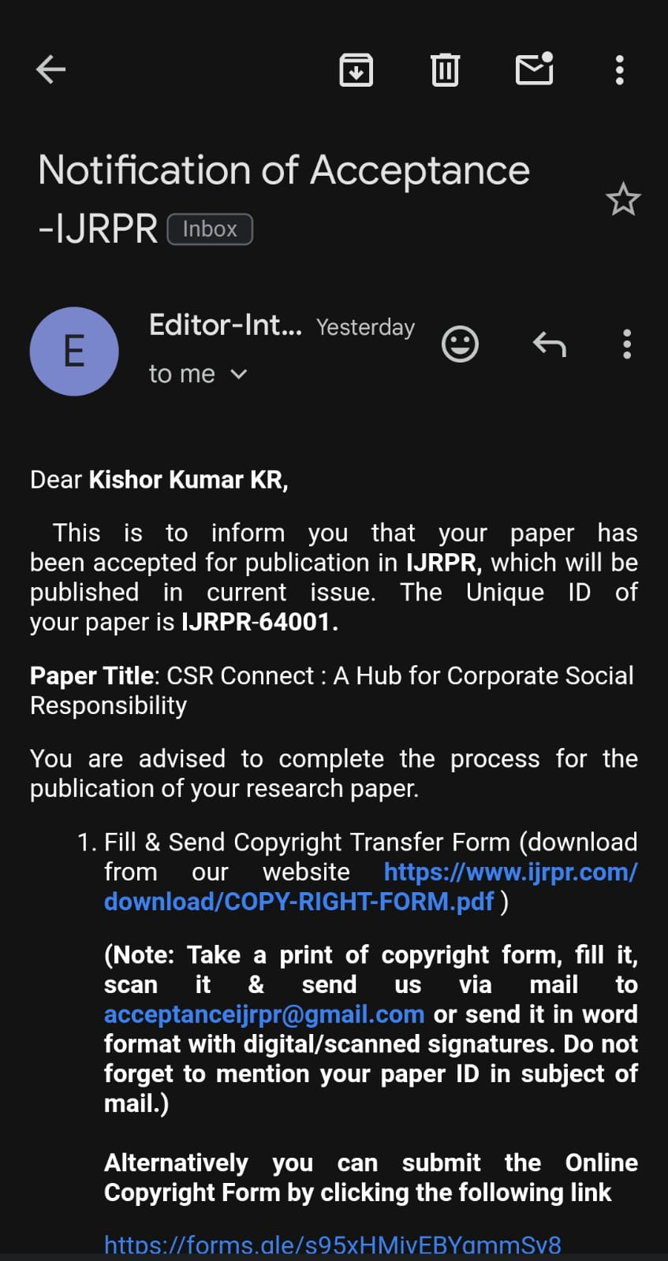
Publication Details

Slide 35

Thank You

